Slide 1
Overview of myEvolv eMAR and OrderConnect Use
Priscilla Morales
The House of the Good Shepherd
Mike Conway
Northern Rivers Family of Services
Notes:
Priscilla

Slide 2
Overview
OrderConnect
OrderConnect is a secure, Web-based and medication management system that integrates with your EHR solution to enhance patient safely and increase physician productivity. You can order new medications from the office or from a mobile device. The system also allows you to create lab and radiology orders and to receive results back electronically.
myEvolv eMAR
eMAR (Electronic Medication Administration Record) is a feature that allows agencies to administer and track remaining quantities of a child’s prescriptions on file. eMAR is entered in its own module, but it will look for information entered in the health section in a child’s record. eMAR is used for medication dispensing.
Notes:
Priscilla

Slide 3
OrderConnect Overview
Notes:
Priscilla

Slide 4
OrderConnect URL’s
OrderConnect Provider Registration:
https://orderconnect.ntst.com/providers
Link where the Admin users can manage their user accounts.
OrderConnect Administrative Tool:
https:/orderconnect.ntst.com/isc_admin
Link to the Admin tool where users with admin rights can set up the facility, modify the setup, etc.
OrderConnect Application:
https://orderconnect.ntst.com
Link to the OrderConnect website where registered users can log into their facility/clinics of choice.
Notes:
Priscilla
(How to setup new providers, talk about verification app problems, new version of Notary Public form)

Slide 5
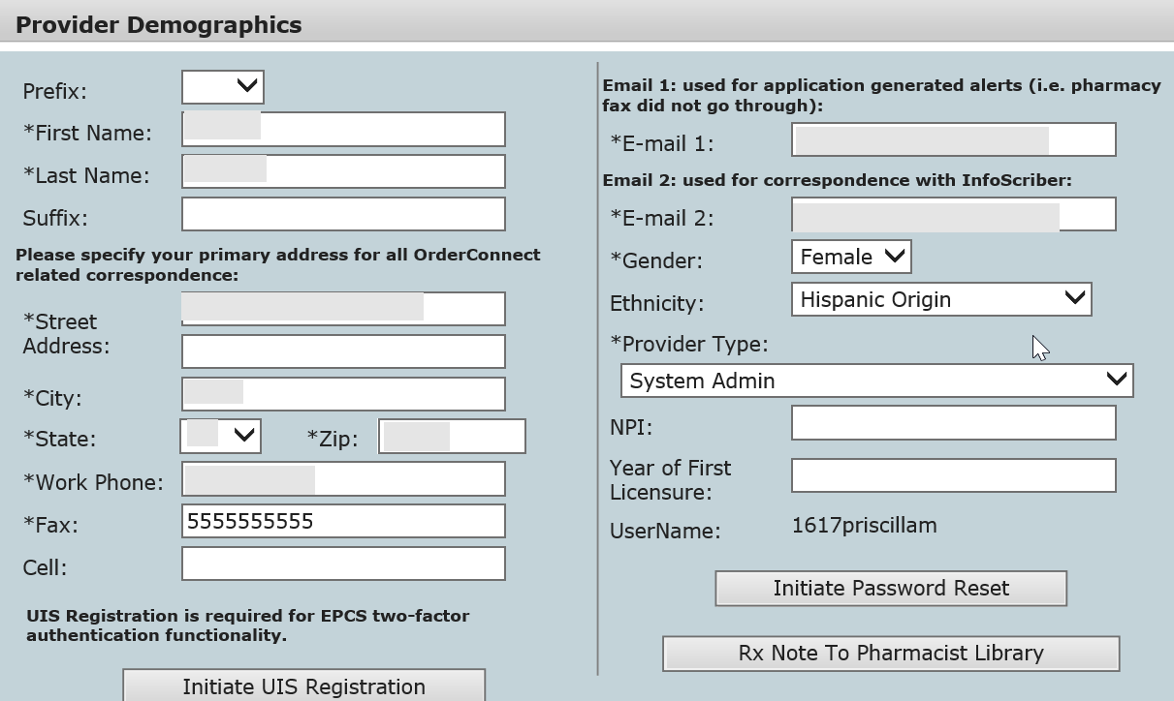
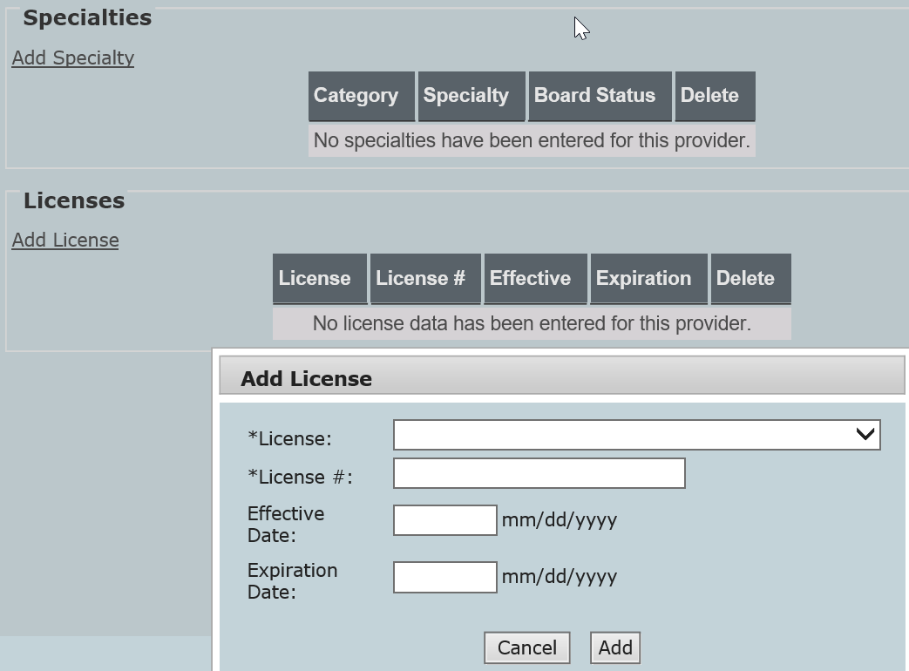
OrderConnect Providers website
A Prescriber Agent is someone who can write a prescription on behalf of a licensed prescriber as a verbal order (e.g. registered nurse).
This is where the provider type and staff contact information is updated.
EPCS two-factor authentication and password resets are initiated here.
Provider specialties and licenses are entered here.
Notes:
Priscilla

Slide 6
OrderConnect Administration Site
Must currently be accessed via Internet Explorer
Assign providers to groups, patients, or prescribers/agents
Identify “agencies” which roughly equate to facilities in Evolv
Add pharmacies by zip code as needed
Add lab locations to allow eLab faxing
Create lab orders and lab panels for streamlined lab requests
Notes:
Mike
(use Training site to demo)

Slide 7
OrderConnect Admin Functions
Notes:
Priscilla

Slide 8
OrderConnect Agencies
AgencyIDs are mapped to staff records in Evolv (option to use “SELECT” for a drop-list)
Can associate providers (prescribers and prescribing agents) to each agency
Can assign specific lab locations to each agency
Notes:
Mike
(Agency = Facility and vice versa)

Slide 9
Adding a lab location and fax
Notes:
Mike

Slide 10
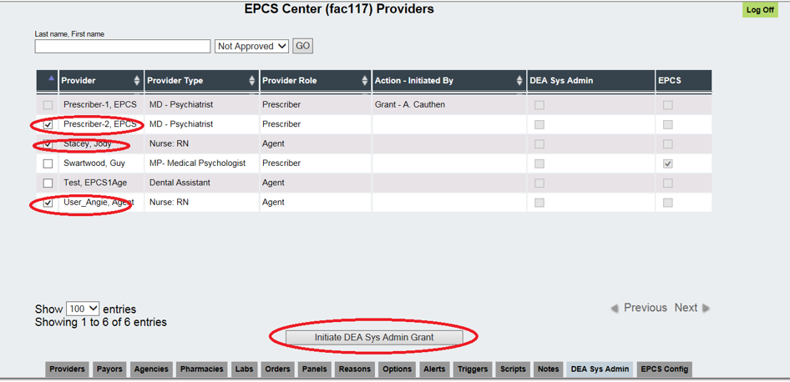
2-step authentication - EPCS
Provider will need to initiate setup by logging into the Prescriber website.
They will receive an email to launch the Verizon interface to authenticate their identity.
Identified DEA System Admins will be prompted to approve.
Electronic prescription for controlled substances (EPCS) is a solution to help address the problem of prescription drug abuse in the United States.
Agency must be authorized by Netsmart to use EPCS functionality.
Granting providers EPCS privileges require two people.
A grantor (DEA System Administrator).
An approver which is a prescriber who has gone through 2 factor authentication already.
Notes:
Priscilla
(Mike - more woes about the identity app)

Slide 11
OrderConnect Application Functions
Notes:
Priscilla

Slide 12
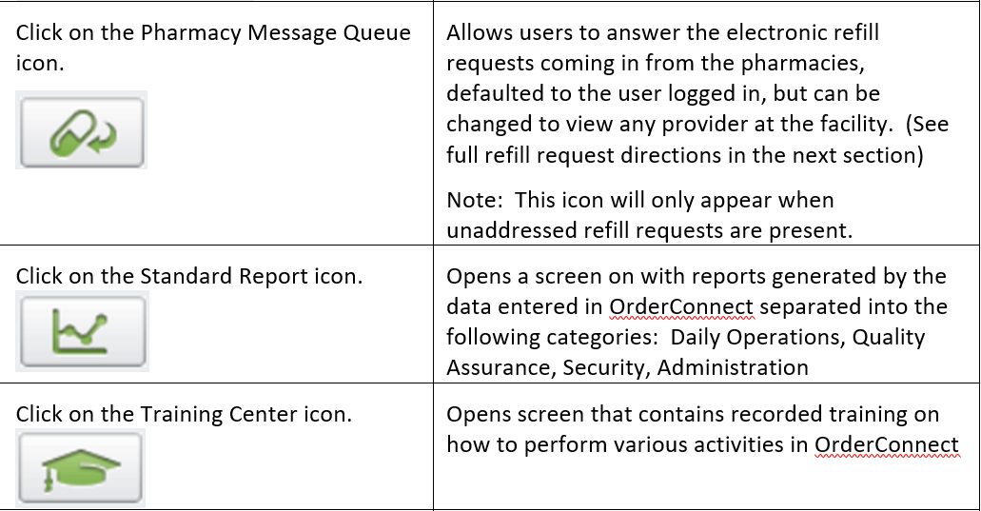
Prescribers Desktop Functions
The OrderConnect Prescribers Desktop displays links to access:
Reports
Electronic Refill Requests
The OrderConnect Inbox
Admin Desktop
And more…
Notes:
Priscilla

Slide 13
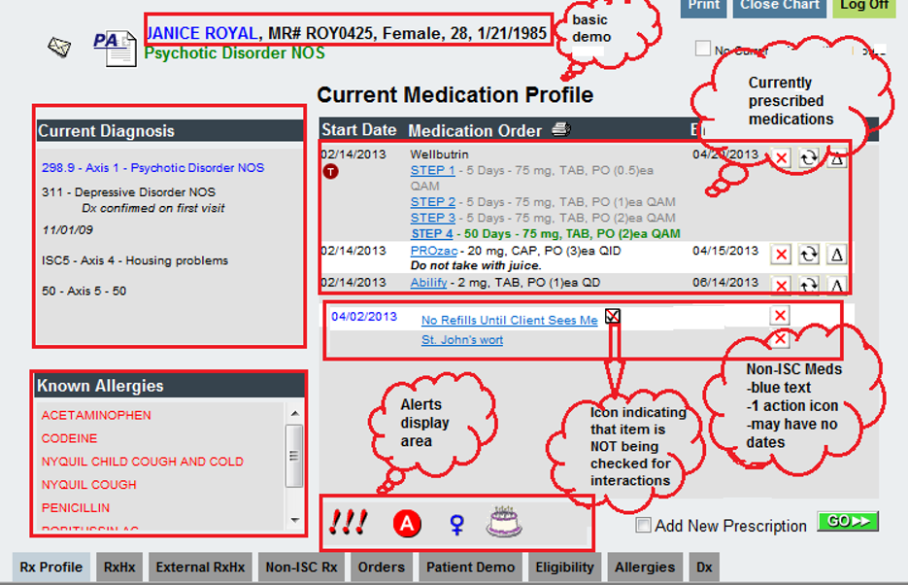
Rx Profile
The Rx Profile tab is the ‘Home Page’ of all client records. This tab provides a high-level overview of the patient record.
The Current Medication Profile will list all diagnoses that are active, basic demographic information, any known allergies, all current medications, and icons indicating if there are possible suicide risks, adverse drug to drug/food interactions, or pregnancy alerts (located at the bottom center of the screen in the alert area).
Notes:
Priscilla

Slide 14
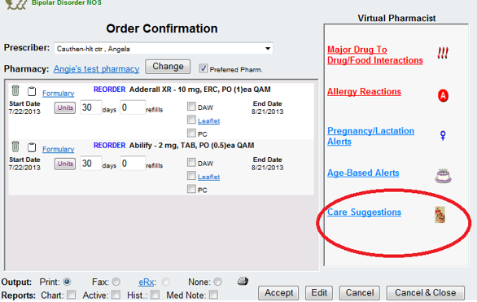
Triggers/ Patient Care Suggestions
Triggers or Patient Care Suggestions allow a facility to create their own clinical alerts by setting the criteria with which to trigger it in a client record inside OrderConnect.
For example, if your facility would like for clients to obtain blood levels each time that a NEW order for Clozaril is written, the Care Suggestion icon will only display on the Order Confirmation page when the new order is being presented.
Once a user has accepted the order for Clozaril and it is no longer being ordered as NEW, the care suggestion icon will no longer display in the record.
Notes:
Priscilla

Slide 15
Alerts Override
Drug-Allergy interaction
Drug-Drug interaction
Drug-food interaction
Drug-ethanol interaction
Drug-lab interaction
Drug-tobacco interaction
Drug-disease (indication) interaction
Drug-pregnancy interaction
Drug-lactation interaction
General precautions interaction
Therapeutic class duplication
Therapeutic class antagonism
Ingredient duplication interaction
Warning generated from Validate Profile
Age-based prescribing guidelines
Unknown severity alters
OrderConnect provides the ability to display the following types of interactions and warnings within the client record.
The administrator can determine which of these warnings will be presented to users during the prescribing events.
A facility may elect to hide/suppress any of the available alerts. However, If a user would like to see any non-displayed alerts for a client record, the user can click on the ‘Bypass Filters- Show All Alerts’ option and view all alerts available.
Administrators may also require that users acknowledge having seen and/or provide prescriber reasoning for these alerts when the alerts are present in a record
Notes:
Priscilla

Slide 16
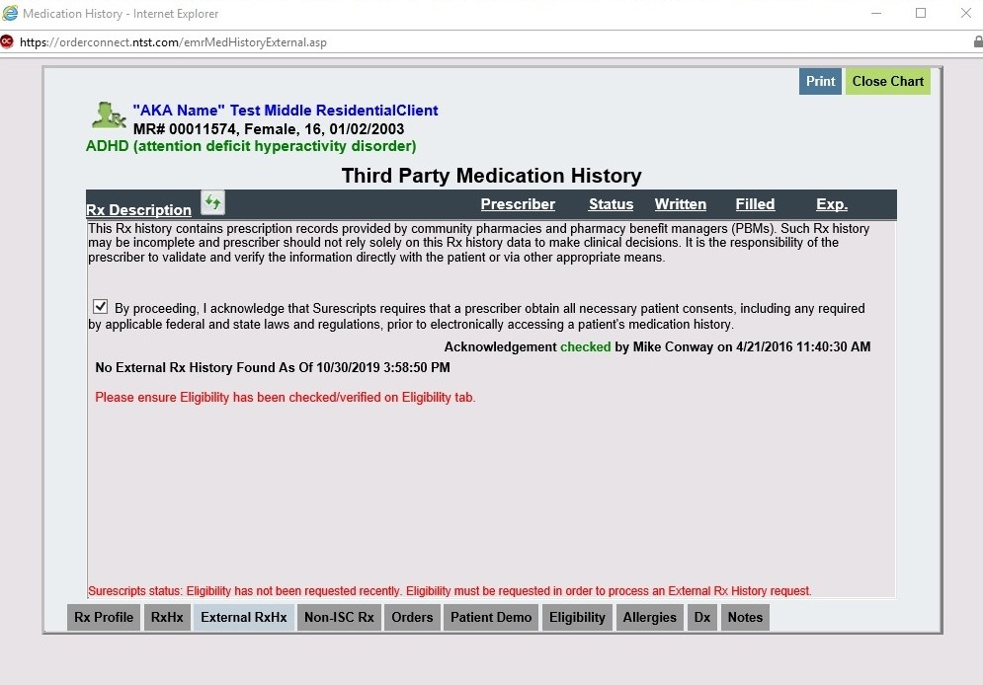
External RxHx
This tab can pull in prescription history stored in the nationwide SureScripts database if a patient eligibility has been checked and the patient has consented for the prescriber to have electronic access to the patient’s medication history.
Notes:
Mike

Slide 17
Non-ISC Medication Entry
The Non-ISC Rx (Non-OrderConnect prescription) tab is used to record medications prescribed by a physician not available via the OrderConnect drug library.
These are manually entered medications that will feed the EHR. Additionally, this tab can be utilized for posting client-specific comments or directives on the Rx Profile page of the client record.
An icon depicting a checkmark that has been crossed out in a white box will appear next to the name of any item entered in the application that cannot be automatically checked for Drug to Drug/Food, Allergy, and Pregnancy/Lactation alerts.
Note: Drug to Drug/Food interactions will NOT be checked against a Medication or remedy that the Application does not recognize.
Notes:
Priscilla

Slide 18
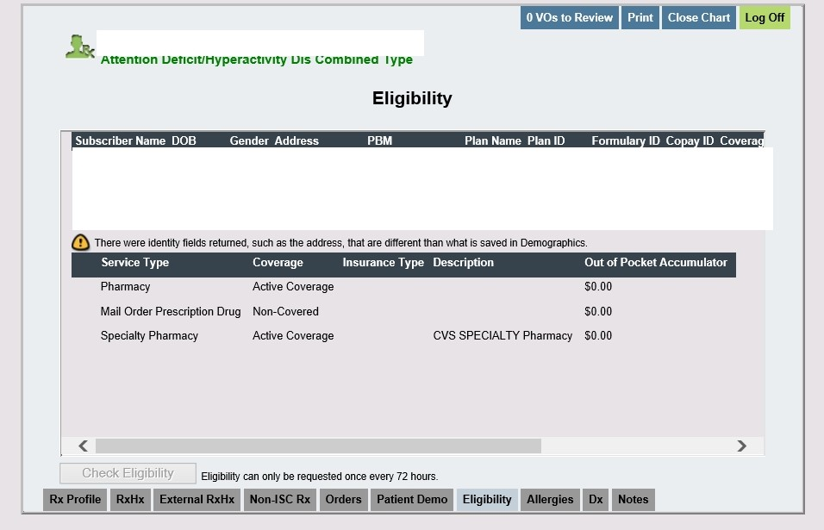
Eligibility
Client eligibility with any associated payers can be checked in real-time from this tab.
Results will show the service type and coverage eligibility as well as any deductible balances for each plan.
Notes:
Mike

Slide 19
myEvolv Agency Setup
Notes:
Priscilla

Slide 20
Linking the program to eMAR
In order to start using the e-Mar module at one of your facilities, you must first link the EMAR event to the program providing service.

Slide 21
Navigation Scheme Security

Slide 22
Worker Role Security

Slide 23
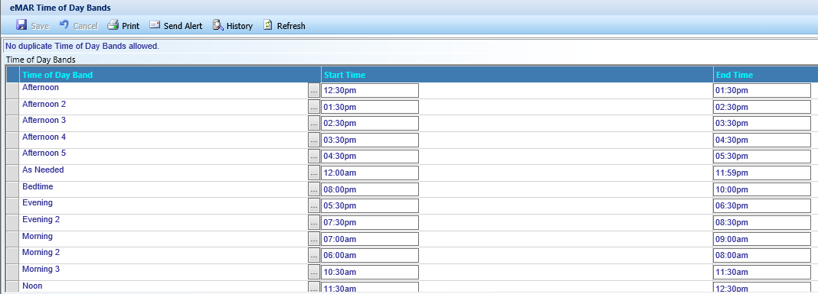
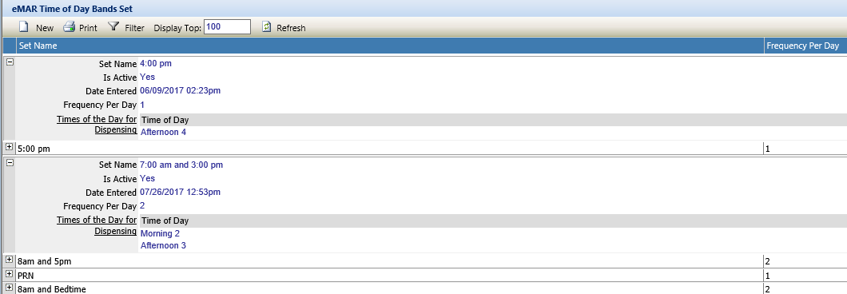
Time of Day Bands
Time of Day Bands are created to identify the time rage for a selected band. The values for Time of Day Band are system provided.
Time of Day Bands SET allows us to group individual time bands into a group. When selecting a medication event to be fed to eMAR, it will require a time band set to be selected that matches the frequency on the prescription order.
Notes:
Priscilla

Slide 24
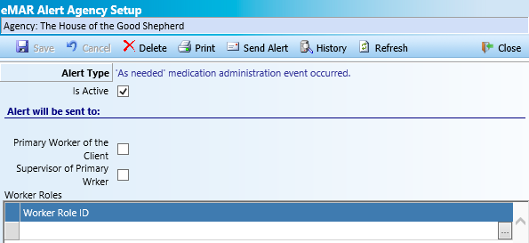
eMAR Alerts
There is an automated alert system for eMAR related events. These are system defined, you only have an option to turn them on or off and select who receives them by either or all of the below options. These will show in the Unread Alerts pane, widget or module.
Primary Assigned worker
Primary Assigned workers’ supervisor.
Worker roles
Notes:
Priscilla
(useless in her opinion ☺)

Slide 25
Entering Medications in the myEvolv Client Record (Non-OC Users)
Notes:
Priscilla

Slide 26
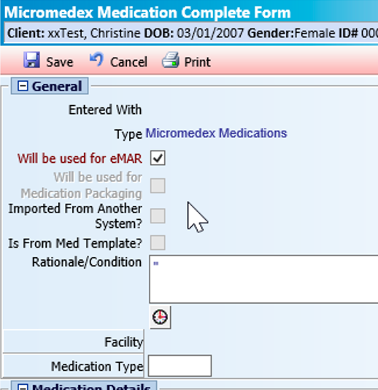
Prescription medications entered via Order Connect will feed this area in myEvolv. Do not enter medications through myEvolv if prescribed through OrderConnect.
Select Micromedex Medications from the New Manual Event button in myEvolv if medication is not entered via O.C.
For dispensation, select Will Be Used for eMAR.
Notes:
Priscilla

Slide 27
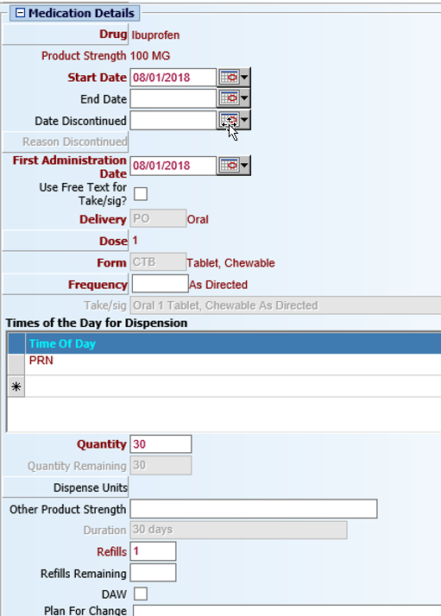
Each check box will turn on additional related fields that will need to be completed.
Start date is required. This is the date the entry is being made.
First Administration Date is required.
Delivery will auto-populate based on the Drug value entered.
Dose is required.
Form will auto-populate based on the Drug value entered.
For PRN’s, the Frequency of ‘As Directed’ must be selected.
Take/Sig will auto-populate based on the Drug value entered. This field can be modified by checking the ‘Is Free Text for Take/sig? box.
Time of Day band is required.
Notes:
Priscilla
(time of day bands can have multiple times associated via band sets, e.g. BID, TID)

Slide 28
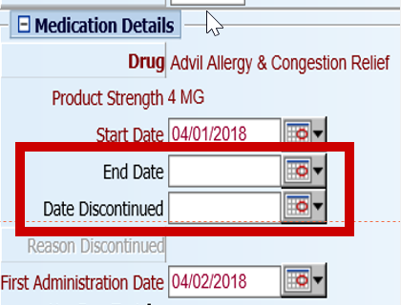
Additional note on the date fields:
End Date – This date should be entered to identify when a medication should no longer be dispensed to the child. The medication will no longer be considered ‘Active’ as of this date. If known, it must be entered.
Discontinued Date – This date should be entered when a medication should be stopped immediately and it is prior to the End Date above.

Slide 29
myEvolv eMAR
Notes:
Priscilla

Slide 30
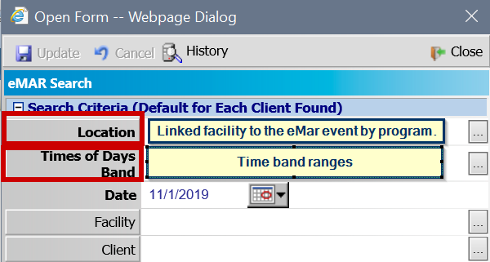
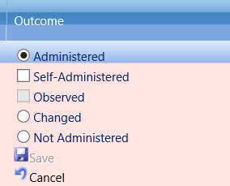
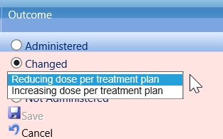
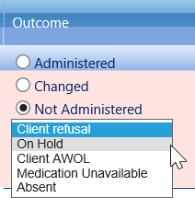
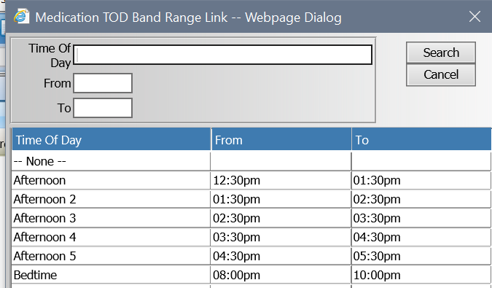
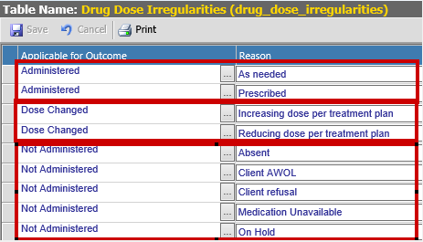
eMAR
Notes:
Priscilla

Slide 31
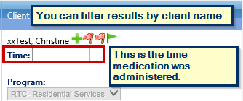
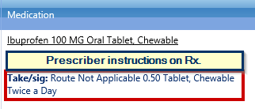
eMAR
White means nothing has been done with this medication dispensation.
Pink means that you selected the medication to make changes.
You can only dispense one medication at a time.
Green means you have dispensed and saved the medication in the eMAR.
Notes:
Priscilla

Slide 32
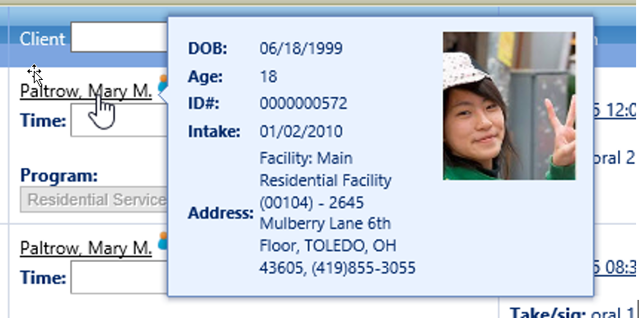
Did you know you can verify the clients’ picture by hovering over their name?
Notes:
Priscilla

Slide 33
Resources
OC Application User Guide- Section 1 (Train the Trainer Guide)
OC Application User Guide- Section 2 (Tab Fonctionnalité)
OC Application User Guide- Section 3 (Full Suite Functionality)
OrderConnect Provider Registration: https://orderconnect.ntst.com/providers
Link where the Admin users can manage their users accounts.
OrderConnect Administrative Tool: https:/orderconnect.ntst.com/isc_admin
Link to the Admin tool where users with admin rights can modify the facility setup, etc.
OrderConnect Application: https://orderconnect.ntst.com
Best practice is to have providers access O.C from within myEvolv client record. This forces a refresh of the EMR.
OrderConnect Support: netsmartsupport@ntst.com
OrderConnect Resource Group on NetsmartCares Community Portal. (This is for all Netsmart care record solutions).

