Slide 1
Form Design - Best Practices and Deep Dive
Presented by
Dean Corbin
The House of the Good Shepherd
Sara Carter
Multnomah County, Oregon

Slide 2
Introduction
Two experienced (shall we say “grizzled”) form designer pros will share form building lessons learned and at lesson’s end you will be able to:
Use the pointers shared to be better form builders
Consider the downstream repercussions of form design setup
Use tips, tricks and identify best practices
Includes a tour of the form designer tool with a focus on the lesser known attributes and options.

Slide 3
Training Outline
Lesson 1: Best Practices and Tips for Form Design
What to consider when adding/creating new fields
Template forms
Lesson 2: Deep Dive on Lesser-known Form Design Functionality
Tour of Form Designer Tool properties
Lesson 3: Introduction to NX Form and Test Designer Documentation
Excellent documentation exists on the wiki
Notes:
Lesson descriptions should be brief.

Slide 4
Lesson 1: Best Practices and Tips for Form Design
At the end of this lesson you will be able to:
Determine form family to use to design new forms in formset
Use EventLog, Form Family, and Form Family Extensible fields and identify best practice for when to use each when adding new fields
Create user-defined fields so they can be re-used on other forms
Understand why you might want to create a Template form in each form family

Slide 5
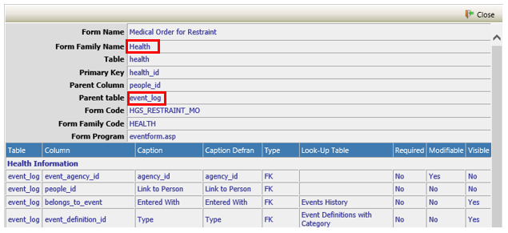
Lesson 1: Best Practices and Tips for Form Design
How do I determine which form family to use?
Open an event from the formset member.
Right click and select “Form Information”.
Form info shows that this formset is using events built with the Health form family, which is an event based form family.
Form Info

Slide 6
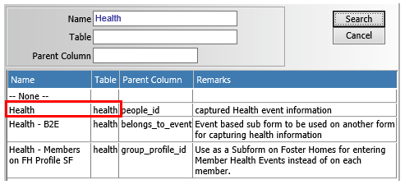
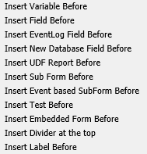
Lesson 1: Best Practices and Tips for Form Design
Head over to the Form Designer
Select “Health” form family – it confirms that this form family stores its data in the health table.
If you can Add an EventLog Field to the form, it is an Event-based formset family. EventLog fields are in the event_log table of the database.
When you add a Field to the form, these fields’ values are stored in the form family table– in this case the health table of the database.
When you add a New Database Field, these fields’ values are stored in the form family extensible table – in this case, the health_x table of the database.

Slide 7
Lesson 1: Best Practices and Tips for Form Design
Previously created user_defined fields can be re-used!
When you add a field to the form, in the Insert Field you see a combination of form family fields and user_defined (form family_x) fields that someone created previously.
User_defined fields can be used on multiple forms within the same form family, so name carefully
Pick generic but meaningful names – it’s a fine balance!
DON’T: udf_datetuberculosistestconducted
DO: udf_test_date
DO: prefix your table names– avoid namespace collisions!
There is a limit on how many user_defined columns can be added to the form family_x tables (1,080) – aim to re-use as much as possible.

Slide 8
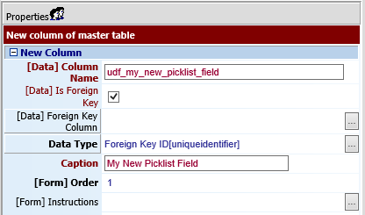
Lesson 1: Best Practices and Tips for Form Design
Pro Tip - Creating Re-Usable Pick List Fields:
Do Not Leave Foreign Key Column Blank!
What do I put there?
For User-Defined Tables, always select
FK Column Name: user_defined_lut_id
For Other Lookup Tables
Depends on the Look Up Table selected
No Simple Solution, but some common examples:
If LUT is for Clients, select FK Column Name: people_id
If LUT is for Staff, select FK Column Name: staff_id
If LUT is for Program, select FK Column Name: program_info_id
If LUT is for Facilities, select FK Column Name: group_profile_id

Slide 9
Lesson 1: Best Practices and Tips for Form Design
Pro Tip - For adding form fields, follow this logic:
Can I use an EventLog Field?
benefits and dangers of repurposing
Pros: Show on canned reports, more likely to be in subreport views
Cons: Some EventLog fields have specific uses in the system: date_entered, final_approval_by
If not, can I use a Form Family Field?
don’t create user_defined unless you must but try to keep data tidy – report writers will thank you!
also may be included in some subreport views
If not, can I use a previously created User-Defined Field?
If not, create a New Database Field (new User-Defined Field).

Slide 10
Lesson 1: Best Practices and Tips for Form Design
Pro-Tip - Booleans vs Lookup Tables
Checkboxes are not necessarily the best choice to represent Yes/No data on a form.
Difference on form in myEvolv
Difference when printing form
Required Field – can’t make a checkbox required and leave it blank if “No”
Same form logic available with JavaScript for LUT approach, just a little more code

Slide 11
Lesson 1: Best Practices and Tips for Form Design
Label and Variable Fields vs Memo and Remarks
Use label and variable fields in cases where you do not need to store information in the database, but need to display for printing or review
Format Variable Fields using HTML
Label fields include formatting
Wiki Links
Add Text Label Field
https://wikihelp.ntst.com/myEvolv/myEvolv_Administration_Guide/Customize_Forms/Basic_Form_Design/Added_Formatted_Text_to_a_Form
Convert Variable Field to Label Field
https://wikihelp.ntst.com/myEvolv/myEvolv_Administration_Guide/Customize_Forms/Basic_Form_Design/Added_Formatted_Text_to_a_Form/Convert_Variable_Elements_to_Label_Elements

Slide 12
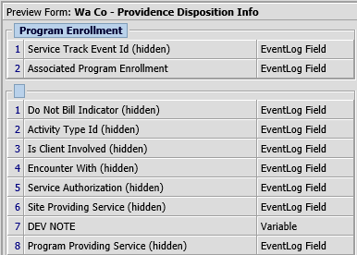
Lesson 1: Best Practices and Tips for Form Design
Template forms in each form family
Uniformly hide Service-Related Encounter fields
Standardize field labels across forms
Instead of copying from Netsmart forms, copy from your own template which saves time
Developer Notes - Hidden Variable field with Default Value, use to track changes and reasons for specific setup

Slide 13
Lesson 1: Best Practices and Tips for Form Design
Template forms in each form family
Standardized Form Header (Agency Use Only)
Lump the myEvolv required fields together
Separation from the clinical data
If changes are needed to this section, retroactive change may not be a problem.
Be aware of how your fields might be “hiding”
Mix of defaulted and not-defaulted
Small fields AFTER Memos
Use labels to push bottom of form down

Slide 14
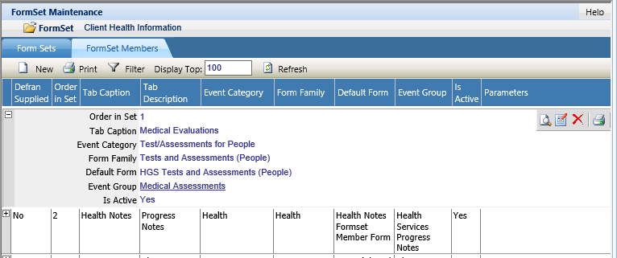
Lesson 1: Best Practices and Tips for Form Design
Formset default form pointers
Make it it’s own form - not used for any events and use obvious form name
Distill to the most useful information across all events that might be displayed there.
You may need to tweak what columns show or the labels for the columns and you don’t want to mess with an event form.
Future updates to the event form will not inadvertently affect the listing
Is Listed, Use for Filter, Order By and Is Order Descending come into play here. We’ll cover in Lesson 2

Slide 15
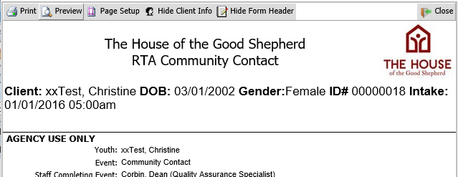
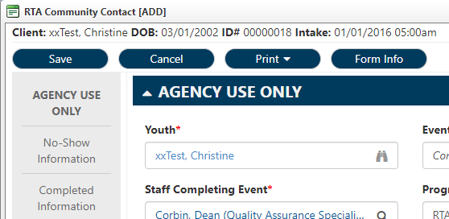
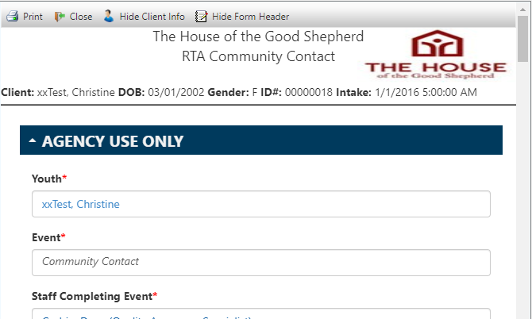
Lesson 1: Best Practices and Tips for Form Design
Form Naming Convention
Your form name may be more prominent than you would expect, especially on print.
Adding “zz” to the beginning may not be your best approach to retired forms because that will show on old documentation.
Use the form code or the hidden variable developer’s notes to keep track of your old forms
Temporarily add “NEW” to new forms to easily find them for attaching to events and editing.

Slide 16
Lesson 1: Best Practices and Tips for Form Design
The Ol’ “Retro Form Change Problem”
Changing a LIVE form design does not change only how the form looks on events going forward but will also change the appearance of your previously entered events.
Depending on the nature of the change, you may need to employ versioning.
Captions, ordering, sizing, etc. – small retro changes might be tolerable
Adding fields – Might be OK, but it will look like it was omitted old events
Removing fields – Strongly advise against – no data loss but it will look like the field never existed
Versioning in a Nutshell: Copy current form, make changes to new form, create new event for new form and then activate new/deactivate old events at the same time.
Pro-Tip
Retiring an Obsolete Event
Should I deactivate old events?
Did you know?
When an event is not marked Active, it hides the event from Canned Report parameters?
What do I do?
You can essentially deactivate an event by just removing Add permissions to all roles. That way, the event is still selectable for Canned Reports

Slide 17
Lesson 1: Best Practices and Tips for Form Design
Questions?
Notes:
Wrap-up

Slide 18
Lesson 2: Deep Dive on Lesser-known Form Design Functionality
Objectives
Deep Dive on lesser-known form design functionality (JavaScript covered in other sessions)
Explain what form properties and field design properties do, provide examples, explain when useful
Demonstrate how to use two different forms in Event Setup to manage form information entry

Slide 19
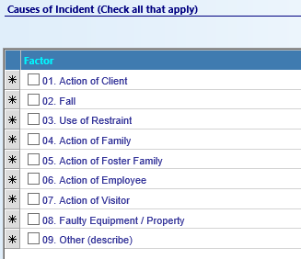
Driving Form Line
What does it do?
Turns a subform into a multi-select form control.
How does it work?
If your subform has a foreign key field on it, you can designate it the driving form line. When the subform renders, it will prepopulate the subform with one line per picklist item in the LUT selected for that FK field.
Why would you use it?
Show all possible options in picklist, make data entry faster

Slide 20
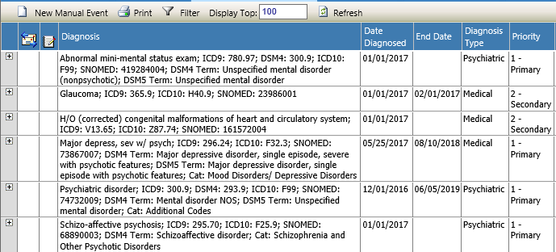
List Condition Code
What does it do?
Allows you to filter a formset member’s listing of events.
How does it work?
Works like the SQL Code field on a subform. You provide SQL as though part of a WHERE clause that will filter the events that list on the subform.
Why would you use it?
If you want a formset member that shows only active (end_date IS NULL)

Slide 21
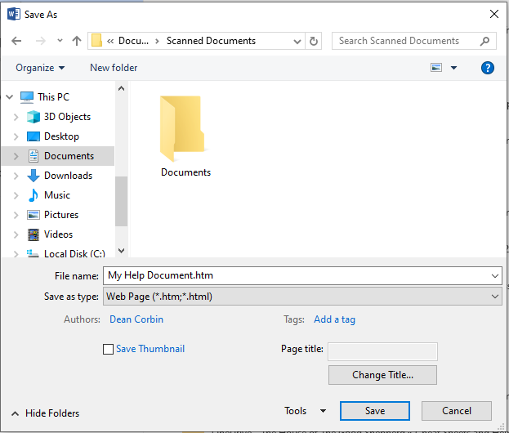
Help File
You can create html documents with Microsoft Word. Save As… Web Page
What does it do?
Allows agencies to create HTML help documents that can be linked to individual forms for user to access.
How does it work?
You upload files to the server and then provide the filename and extension in the help file field on the form.
Hosted clients will need to submit a ticket for access to upload files.
Why would you use it?
To make finding instructions for the use of forms easier for your users to find.

Slide 22
JavaScript Hooks
Form Header Properties
Before Save Code
After Save Code
After Delete
Before Load Code (used only by non-subforms)
After Load Code
Properties provide triggers for execution of JavaScript code at various points in the loading of a form other form action.
If you would like to know more about what you can do with these, check out the JavaScript presentations and workshops.

Slide 23
JavaScript Hooks
Field Design Properties
On Load Script - Executes just before default values are calculated in node order but before the HTML DOM exists - can be used to manipulate the formXML stuff and adjust how a default value might work.
On Click Script - only use for Booleans. Executes the script when the form element is clicked.
On Change Script - use for all other field types. Executes the script when the value in the form field changes on blur.

Slide 24
JavaScript Hooks
Field Design Properties
Default Value - for Foreign Key fields, it needs a GUID - remember it is all caps for Classic, Lowercase for NX.
Supplemental Handout: A DI virtual view to help you lookup the GUID values of User-Defined LUT picklist items.
Disable Rule - looking for something that evaluates to true (disabled = true) or false (disabled = false)

Slide 25
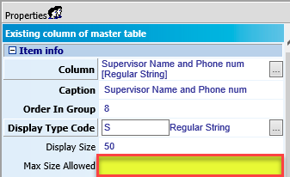
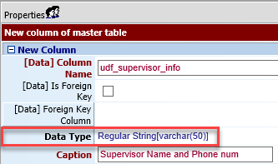
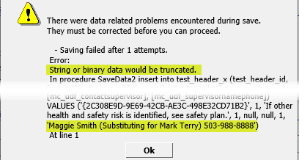
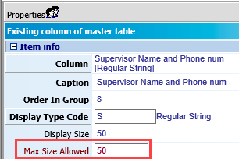
Max Size Allowed
What does it do?
Limits the number of characters that a user may enter into a string or numeric field.
How does it work?
You set the number of characters that can be used in a field. When the user hits that limit, they can no longer type.
Why would you use it?
If you have a regular string column (length 50) but allow users to type more than 50 characters in a string field, myEvolv will cut off the input at 50 characters and the user will not know but receives error message.

Slide 26
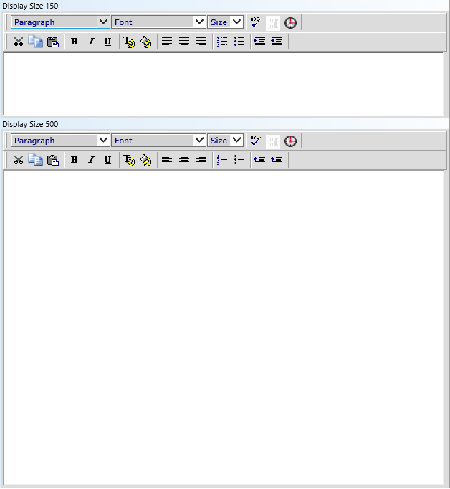
Display Size
Why would you use it?
Make your forms looks better!
Limit scrolling time
Trick clinicians into thinking forms are not as arduous to complete.
What does it do?
Changes the size of string, remarks and memo fields as they are displayed on forms.
How does it work?
Enter an integer number that represents the display size of the form field.
Strings - the number represents horizontal length of the field.
Remarks - the number represents lines of text that is displayed without needing to scroll.
Memos - the number represents the number of pixels tall that the field will render.

Slide 27
Is Listed
What does it do?
Shows a form field in the formset member listing.
How does it work?
If the form is a default form for a formset member, this form field will be a column in the formset member listing.
For other forms, the data in this field will be available in the expanded row view.
Why would you use it?
Allows users to see some fields from a form without needing to click into the event.

Slide 28
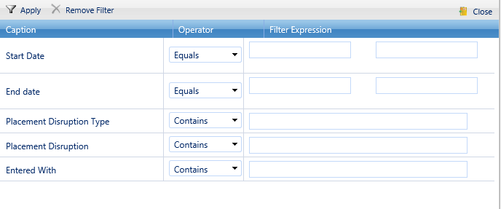
Used For Filter
What does it do?
Allows you to filter on this field in the formset member listing.
How does it work?
If the form is the default form for a formset member, the fields flagged as Used for Filter are available to be used in the filter tool on the formset listing.
Why would you use it?
If you have formset members with long lists of events in them, providing more columns to filter on can help users find what they’re looking for.

Slide 29
Use for Order By & Is Order Descending
What does it do?
Designates the form column that will be used for sorting events on a formset member listing.
How does it work?
If the form is the default form for a formset member, the flagged column will be used to sort the listing of events.
If you select the Is Order Descending checkbox, the order will be reversed.
Why would you use it?
Customized versions of formset members that sort differently for different kinds of users.

Slide 30
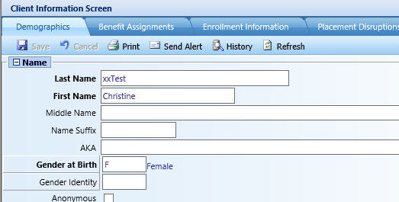
Formset to Call
What does it do?
Turns the selected foreign key field item into a clickable link that launches a related form.
How does it work?
You select a formset to call and the selected item displays as a link. The value of the selected item is passed in the link so the formset selected must be related.
Why would I use it?
Provides a way for users to lookup, add or edit information about clients or staff and other things without having to leave the event they are working on.

Slide 31
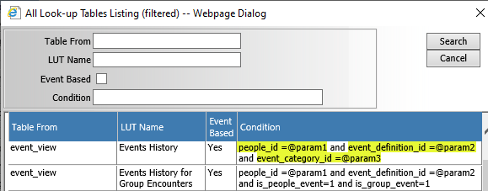
Look-Up Table Used
What does it do?
Designates the look-up table that will be used for the field and what will be displayed in the list.
How does it work?
You choose from available look-up tables, which is filtered based on foreign key id used for the field chosen. Use available conditions in the look-up table list to limit results using parameters entered in depends on fields.
Why would I use it?
Limit results of look-up table list.
Choosing Look-Up Table Used
Depends On = @param1
Depends On (other) = @param2~@param3
Each additional parameter separated by ~

Slide 32
Apply Default on Save
What it does
If your field has a default value expression to it, this makes the execute before save instead of on load.
How it works
Must be used in conjunction with a default value expression.
Why would you use it?
Default value needs to calculate based on multiple fields and you can’t guarantee they will be entered in the correct order so you default the value at the time of saving instead.
Default value code calculates units but needs start and end times in order to do so.
You only want to default a value if the value is left blank at save.
Override user inputs

Slide 33
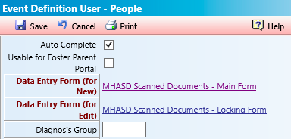
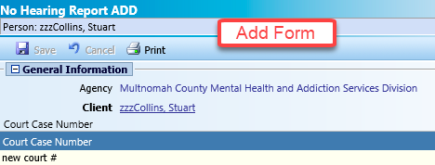
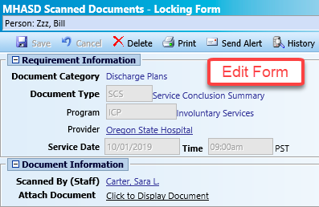
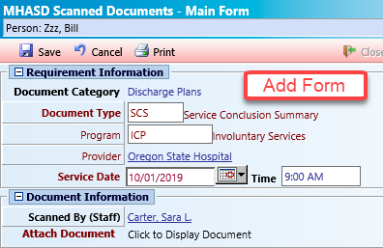
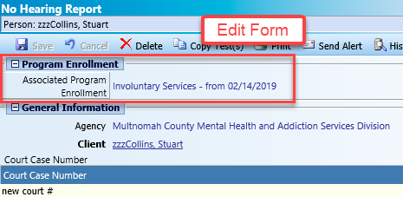
Event Setup – Add/Edit Forms
In Events Setup, use two different Data Entry Forms for new and for edit to manage fields differently when initially adding and when editing
“Lock” fields using Is Modifiable property
Use Is Visible property to hide fields
Include additional fields on Edit and make other fields required – e.g. Two phase required field logic with different staff
Setup a master form with all fields then copy and modify add and edit forms
Differentiate the form names for Add and Edit

Slide 34
Lesson 2: Deep Dive on Lesser-known Form Design Functionality
Questions
Notes:
Wrap-up

Slide 35
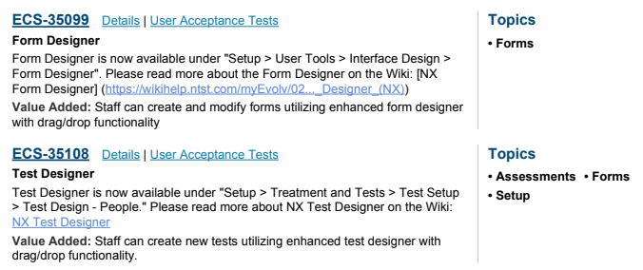
Lesson 3: Introduction to NX Form and Test Designer Documentation
New Form Designer and Test Designer released in 10.1.0225
Excellent wiki documentation uploaded at the same time. Links in the Release Notes
Wiki Links
Form Designer
https://wikihelp.ntst.com/myEvolv/myEvolv_NX_Administration_Guide/Customize_Forms_(NX)/Form_Designer_(NX)
Test Designer
https://wikihelp.ntst.com/myEvolv/myEvolv_NX_Administration_Guide/Manage_Treatment_Plans%2C_Tests%2C_and_Assessments_(NX)/Test_Designer_(NX)

Slide 36
Training Summary
Expert Advice: There is a lot to learn when it comes to form design, and you may feel overwhelmed when going through sessions like this. Don’t expect to retain it all at once and be able to put everything to good use immediately, but reference this presentation as you encounter new challenges in form design. It is often not until a concept becomes relevant to you that you become ready to really learn it.
Questions?

