Slide 1
Workflows-How to Make them Work!
Presented by
Trisch Edmonds, MSW LSW Natalie Thomas, LCSW
Director of Social Service Informatics Associate Director of CQI/EHR Administrator
The Bair Foundation Spurwink

Slide 2
Bair – 8 States over 32 offices
Therapeutic Foster Care and Adoption
Outpatient Services
Family Preservation/Family Services
Using Workflows extensively since implementation and went live with scheduling in place.
95% of our forms are connected to scheduling.
Currently operating over 3,000 schedules in our system.
Trisch Edmonds MSW, LSW
Director of Social Service Informatics
Evolv Implementation 2012
Netsmart Solution Site – 2016
Netsmart Evolv Mentor - 2017

Slide 3
Spurwink-Diverse services across Maine
Outpatient Services
Therapy Services
Functional Family Therapy
ACT
BHH/OHH
Medication Management
Treatment Foster Care
Children’s Residential and Day Treatment
Child Abuse Evaluations
Therapeutic Preschool
Adult Community Case Management
Using Workflows since implementation and went live with scheduling in place.
Assessments, Treatment Plans, Discharge Summaries and various other requirements are connected to scheduling.
Currently operating over 300 schedules in our system.
Natalie Thomas, LCSW
Associate Director of CQI/EHR Administrator
Evolv Implementation 2016

Slide 4
Introduction
Workflows are an extremely helpful and often underutilized tool in myEvolv. This is likely due to agencies experiencing them as “complicated”, “quirky” or not designed to do what agencies need.
Following this presentation you will have a better understanding of:
Best practices around workflow setup and use
How to work around potential barriers/limitations
Why it is worth it to make workflows “work” for your agency!
Notes:
Natalie

Slide 5
Presentation Outline
Lesson 1: Workflow Basics
Uses, Set up tips, Real life examples
Lesson 2: Workflow “hacks”
Potential Pitfalls, Limitations and how to make them “work” for you anyway
Lesson 3: New/Upcoming Features
Notes:
Natalie

Slide 6
Lesson 1: Workflow Basics
At the end of this section, you will be able to identify:
Workflow uses throughout evolv
Key pieces of information needed to build a successful workflow
Parts of a workflow and what they do
Factors that will ensure success in making workflows “work”
Notes:
Natalie

Slide 7
What are Workflows?
myEvolv’s automatic scheduling functionality (Not to be confused with Routing)
Designed to assist agencies in improving compliance with various internal and external documentation requirements
Events/Tasks are scheduled for users based on agency defined “rules”
Notes:
Natalie

Slide 8
Workflow Benefits
Many uses throughout myEvolv
Eliminates need for external tracking
Provides reminder to staff responsible/supervisor
Task Widget
Service Entry
Alerts
Reportable-provides data around staff compliance for supervisors as well as around agency compliance in general
Easy to see “at a glance” if a client file is out of compliance.
Notes:
Natalie

Slide 9
Example Workflow Uses
Client Documentation Reminders
Clinical/Health Reminders
Reminders of outside documentation requirements
Foster Home Reminders
Staff
Family Cases
Once you start using workflows, your agency will want more!
Notes:
Natalie - Client Doc Reminders-Referral Assessments, PSA, RA, Tx Plans, Discharge Summary
Clinical/Medical Reminders- ER Follow up Visits, AIM Scale, Physicals, Dentals, Eye
Outside Documentation- ACCM EIS, CANS, CAFAS, DX Confirmation BHH
Foster Home-Home Studies, Training, Evals, certifications

Slide 10
Before Starting-Understand Your Agency’s Need
Who is the task for?
Tasks (events) can be scheduled for active or inactive clients, referrals, foster homes, foster home applicants, family cases and staff. Examples:
Active- Tx plan due within ‘x’ days of enrollment
Inactive- Post Discharge Follow up
Referrals-Assessment to determine appropriate treatment/program
Foster homes-Profile assessments, on-site visits
Staff- Required annual trainings
Who is responsible?
Specific worker, worker role or type of assignment to client or group
What is being scheduled?
Any event flagged as “can be scheduled” in Event Set up is available for scheduling
Notes:
Trisch

Slide 11
Overview & Understanding Need of your Agency
When is the task due?
Events are scheduled based upon triggers.
These triggers can be any event in MyEvolv.
Non-event data such as birthday or case initiation date can also serve as triggers for scheduling.
Events can be scheduled any number of days, weeks, months, or years from the trigger date.
Events can also be recurring, for example, every 2 weeks after the enrollment date.
Notes:
Trisch

Slide 12
Overview of Workflow Components
No functional impact-categories for organization
Defines who the rule applies to/doesn’t apply to
What “sets it off”.
Actual task being scheduled/who it is assigned to
Defines when scheduled event will be due, recurrence patterns, compliance interval, additional age based filtering.
Workflow (Header)
Qualifier(s)
Triggers
Event
Schedule
Notes:
Trisch
Qualifiers-program, gender, active/not active, enrollment modifier, foster home applicant status,
Triggers-what starts it (enrollment, event completion, birthday). Define 1X (initial) or recurring (no)
Event-Worker Role, worker assignment type, specific staff, what program you want it schedule in

Slide 13
Initial Event Triggers vs Ongoing Triggers
Initial Event Trigger
Scheduled immediately after a person/group qualifies for a rule.
For example, if a rule dictates that a client enrolled in program X must get a physical exam, the physical exam would be scheduled and flagged as initial without checking for previous existence of the scheduled physical exam.
Ongoing Trigger
Tasks are scheduled in such a way as to keep one-on-hand.
For example, if a rule dictates that a client must receive a review of their treatment plan every 6 months, a new treatment plan task will be scheduled 6 months following the completion of the previous one.
Notes:
Trisch

Slide 14
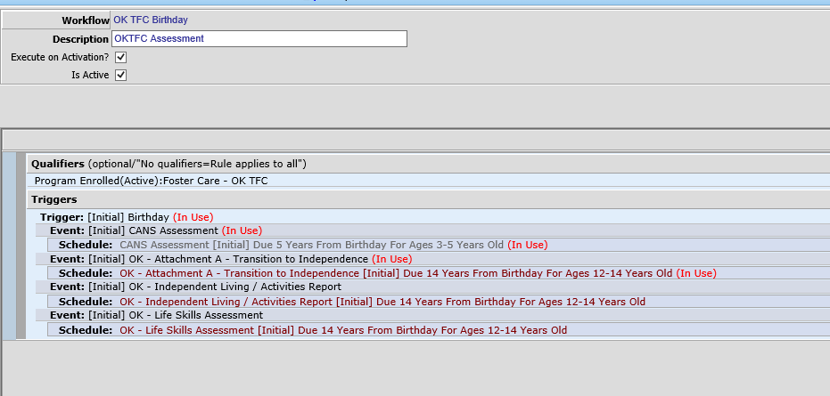
Agency Examples: Birthday Trigger
What does Birthday Trigger mean?
Client Services that are required when a child turns a certain age.
Unique – only trigger that is not an “event” in myEvolv.
Notes:
Trisch

Slide 15
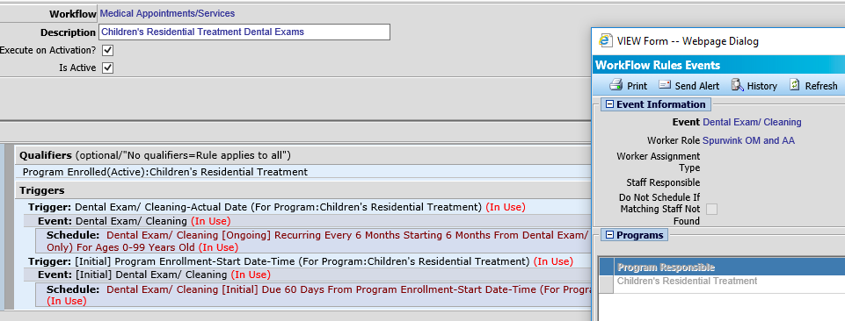
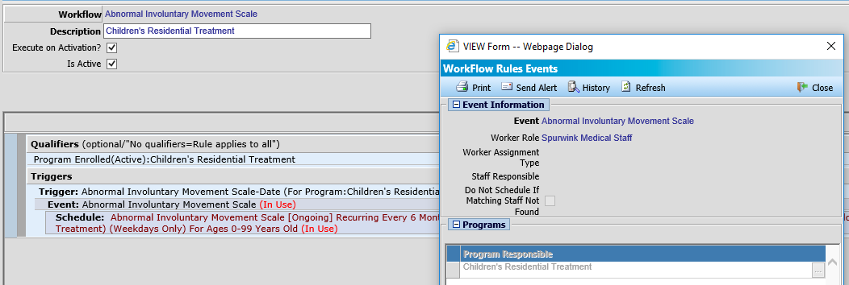
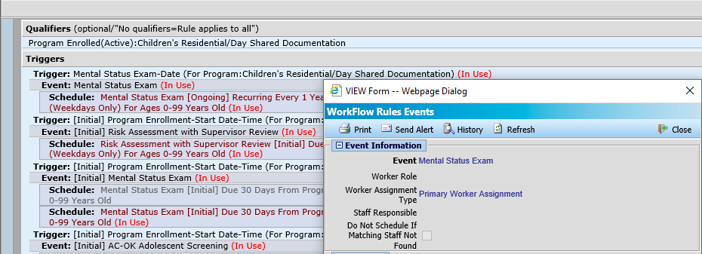
Agency Examples: Scheduling for Different Workers in the Same Program
Use “Worker Role” and “Worker Assignment Type” to schedule for different workers in team based programs.
Enrollment needs to be accurate (matters who is considered “primary”, staff connected with right worker role.)
Notes:
Natalie

Slide 16
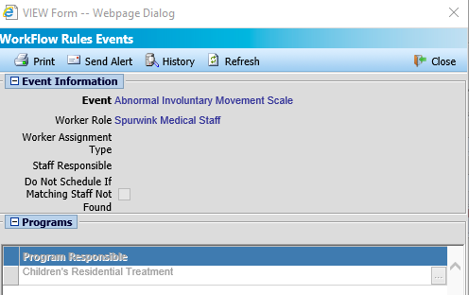
Agency Examples: Scheduling for Different Workers in the Same Program
Be thoughtful about whether you check the “Do Not Schedule if Matching Staff Not Found” checkbox.
In situations where someone should always be assigned a task NOT checking this will assign it to the “wrong” person. This is good because it makes them ask about it and a task is not “lost”
If there are times something should only be scheduled if there is a certain type of worker, check it to stop erroneous task assignment.
Notes:
Natalie - Outpatient program with med management or therapy, or both with different providers and different requirements.

Slide 17
Lesson 2: Workflow “Hacks” (Pitfalls, Limitations and how to make them “work” for you anyway!)
At the end of the section, you will be able to identify:
Common situations that can cause workflow challenges
Limitations of workflows that can cause tasks to be “lost”
Workarounds and suggested practices to ensure that it still “works” to use workflows
Notes:
Trisch

Slide 18
Workflow Barriers/Difficulties
Many agencies give up on using workflows as they can feel unpredictable and complicated.
They do require attention, but understanding their behavior goes a long way to using workflows successfully.
Notes:
Trisch

Slide 19
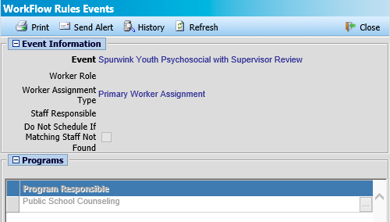
Events Scheduling in the Wrong Program
Be sure to use a Qualifier and select the program your workflow applies to.
Select the correct program on the Trigger and Event levels, ensuring the workflow is paying attention to the correct trigger.
Notes:
Trisch

Slide 20
Issues with Overdue Events
Will not schedule an event in the past.
Training and Comprehension is very important for clinical staff
For reoccurring schedules, will skip the next event if it would be more than 30 days overdue, and schedules for the NEXT occurrence. This causes supervisors and others to lose the “red flag” that something is very out of compliance.
Suggestions
Be sure everyone understands this so they do not “realign” tasks and “lose” overdue events
May need to utilize manual scheduling of events in some situations
DO NOT RUN UTILITY THAT TAKES AWAY ALL WORKFLOWS AND REAPPLIES THEM
Notes:
Trisch

Slide 21
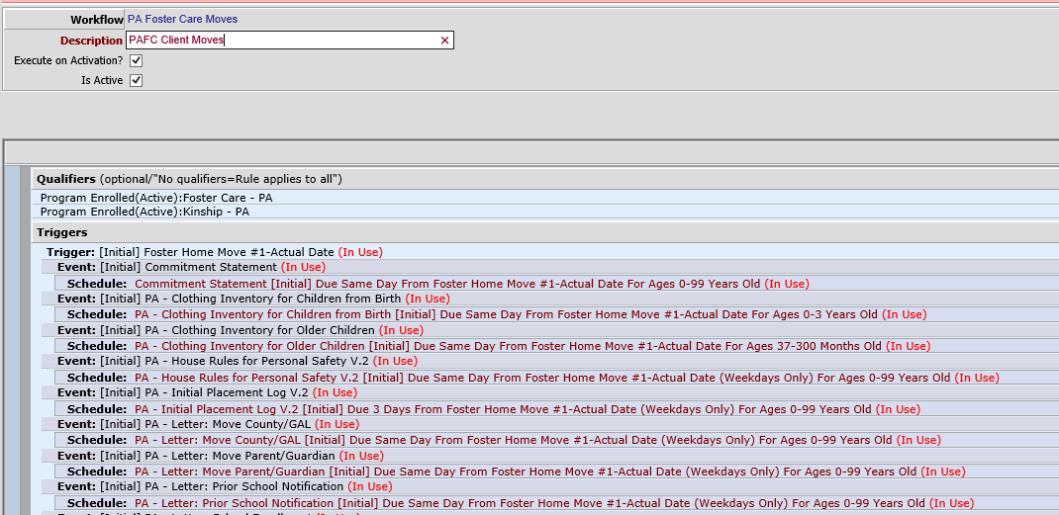
Initial Triggers Only Work Once/ Something Changes and You Need a Trigger
Use “Dummy Events” as triggers.
This can be beneficial if you need an initial trigger to occur more than once in a given process
If you have a client where something changes, and they need an additional set of paperwork (i.e. transfer of facility, adding a service in the same program).
Notes:
Trisch

Slide 22
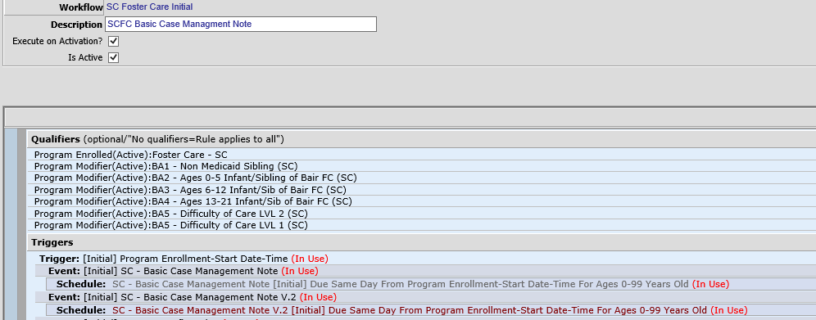
Form Changes /New Schedule Requirement can be Confusing
Add new version to the initial workflow
Make the previous version schedule inactive
New Ongoing Schedule for V2
Make the previous schedule inactive
Create New for Old to Trigger New so none get missed
Notes:
Trisch

Slide 23
Other Woes
Future dated triggers don’t work
myEvolv fires events from the old enrollment if a client is enrolled in a program, discharged, and then re-enrolled in the same program (they come back if you delete them).
Duplicate events
Requirements that use “Program Enrollment” as the first trigger need to be implemented in a program that is already live. (How to get the first instance of something in for existing clients who have been active for more than 30 days?)
Notes:
Natalie

Slide 24
Overcoming Barriers to Workflows
PREPARATION, PREPARATION – Workflow preparation is key, understand all concepts, what you are trying to obtain, and map out on paper outside of system first.
Attending Trainings/Learning Services Courses/Mentor Hours – the better the understanding of concepts, the easier workflows are to operate.
When form or policy changes occur that cause a change in existing workflows, take one step at a time and test in development first.
TRAINING
Train workers extensively on how workflows work so if they do get behind scheduled, they understand how to edit dates to bring everything up to date.
Teach Supervisors on how to monitor workflows, why an item scheduled and how to adjust when a change in process occurs.
Notes:
Natalie

Slide 25
Lesson 3: New/Upcoming Features
After this section you will be excited about some of upcoming solutions to your workflow woes!
Notes:
Natalie

Slide 26
Upcoming Features
Initial Triggers will work more than one time. Will be helpful in situations when you need something to happen multiple times, but only if the trigger precedes it.
Future dated triggers will correctly schedule the next event. For example, a program has to draft a treatment plan ahead of time but needs the date to be the date of the meeting in which it will be reviewed.
Program re-enrollment bugs will be fixed
Initial events will fire as they should based on enrollment trigger
Events from past recurring schedule from old program will not longer continue in new enrollment
Notes:
Natalie

Slide 27
Questions?

